Slide 1


Cyborg Life
How Humans and Digital Tools will Merge in the Coming Years
Lee Rainie
NEFLIN
4.25.25
Notes:
Lee Rainie will discuss the impact of new digital intelligence and how people will operate in with AI agents, sidekicks, and friends. He will also explore what could go right or go wrong as the co-intelligence relationship evolves.

Slide 2
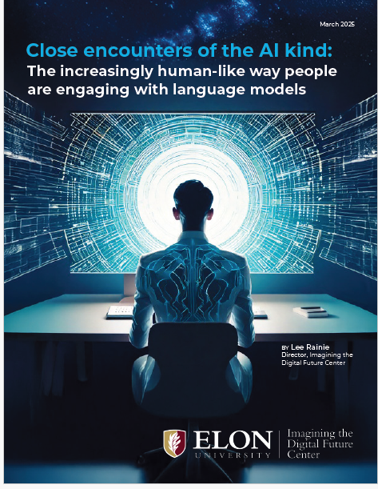

https://imaginingthedigitalfuture.org/reports-and-publications/close-encounters-of-the-ai-kind/

Slide 3
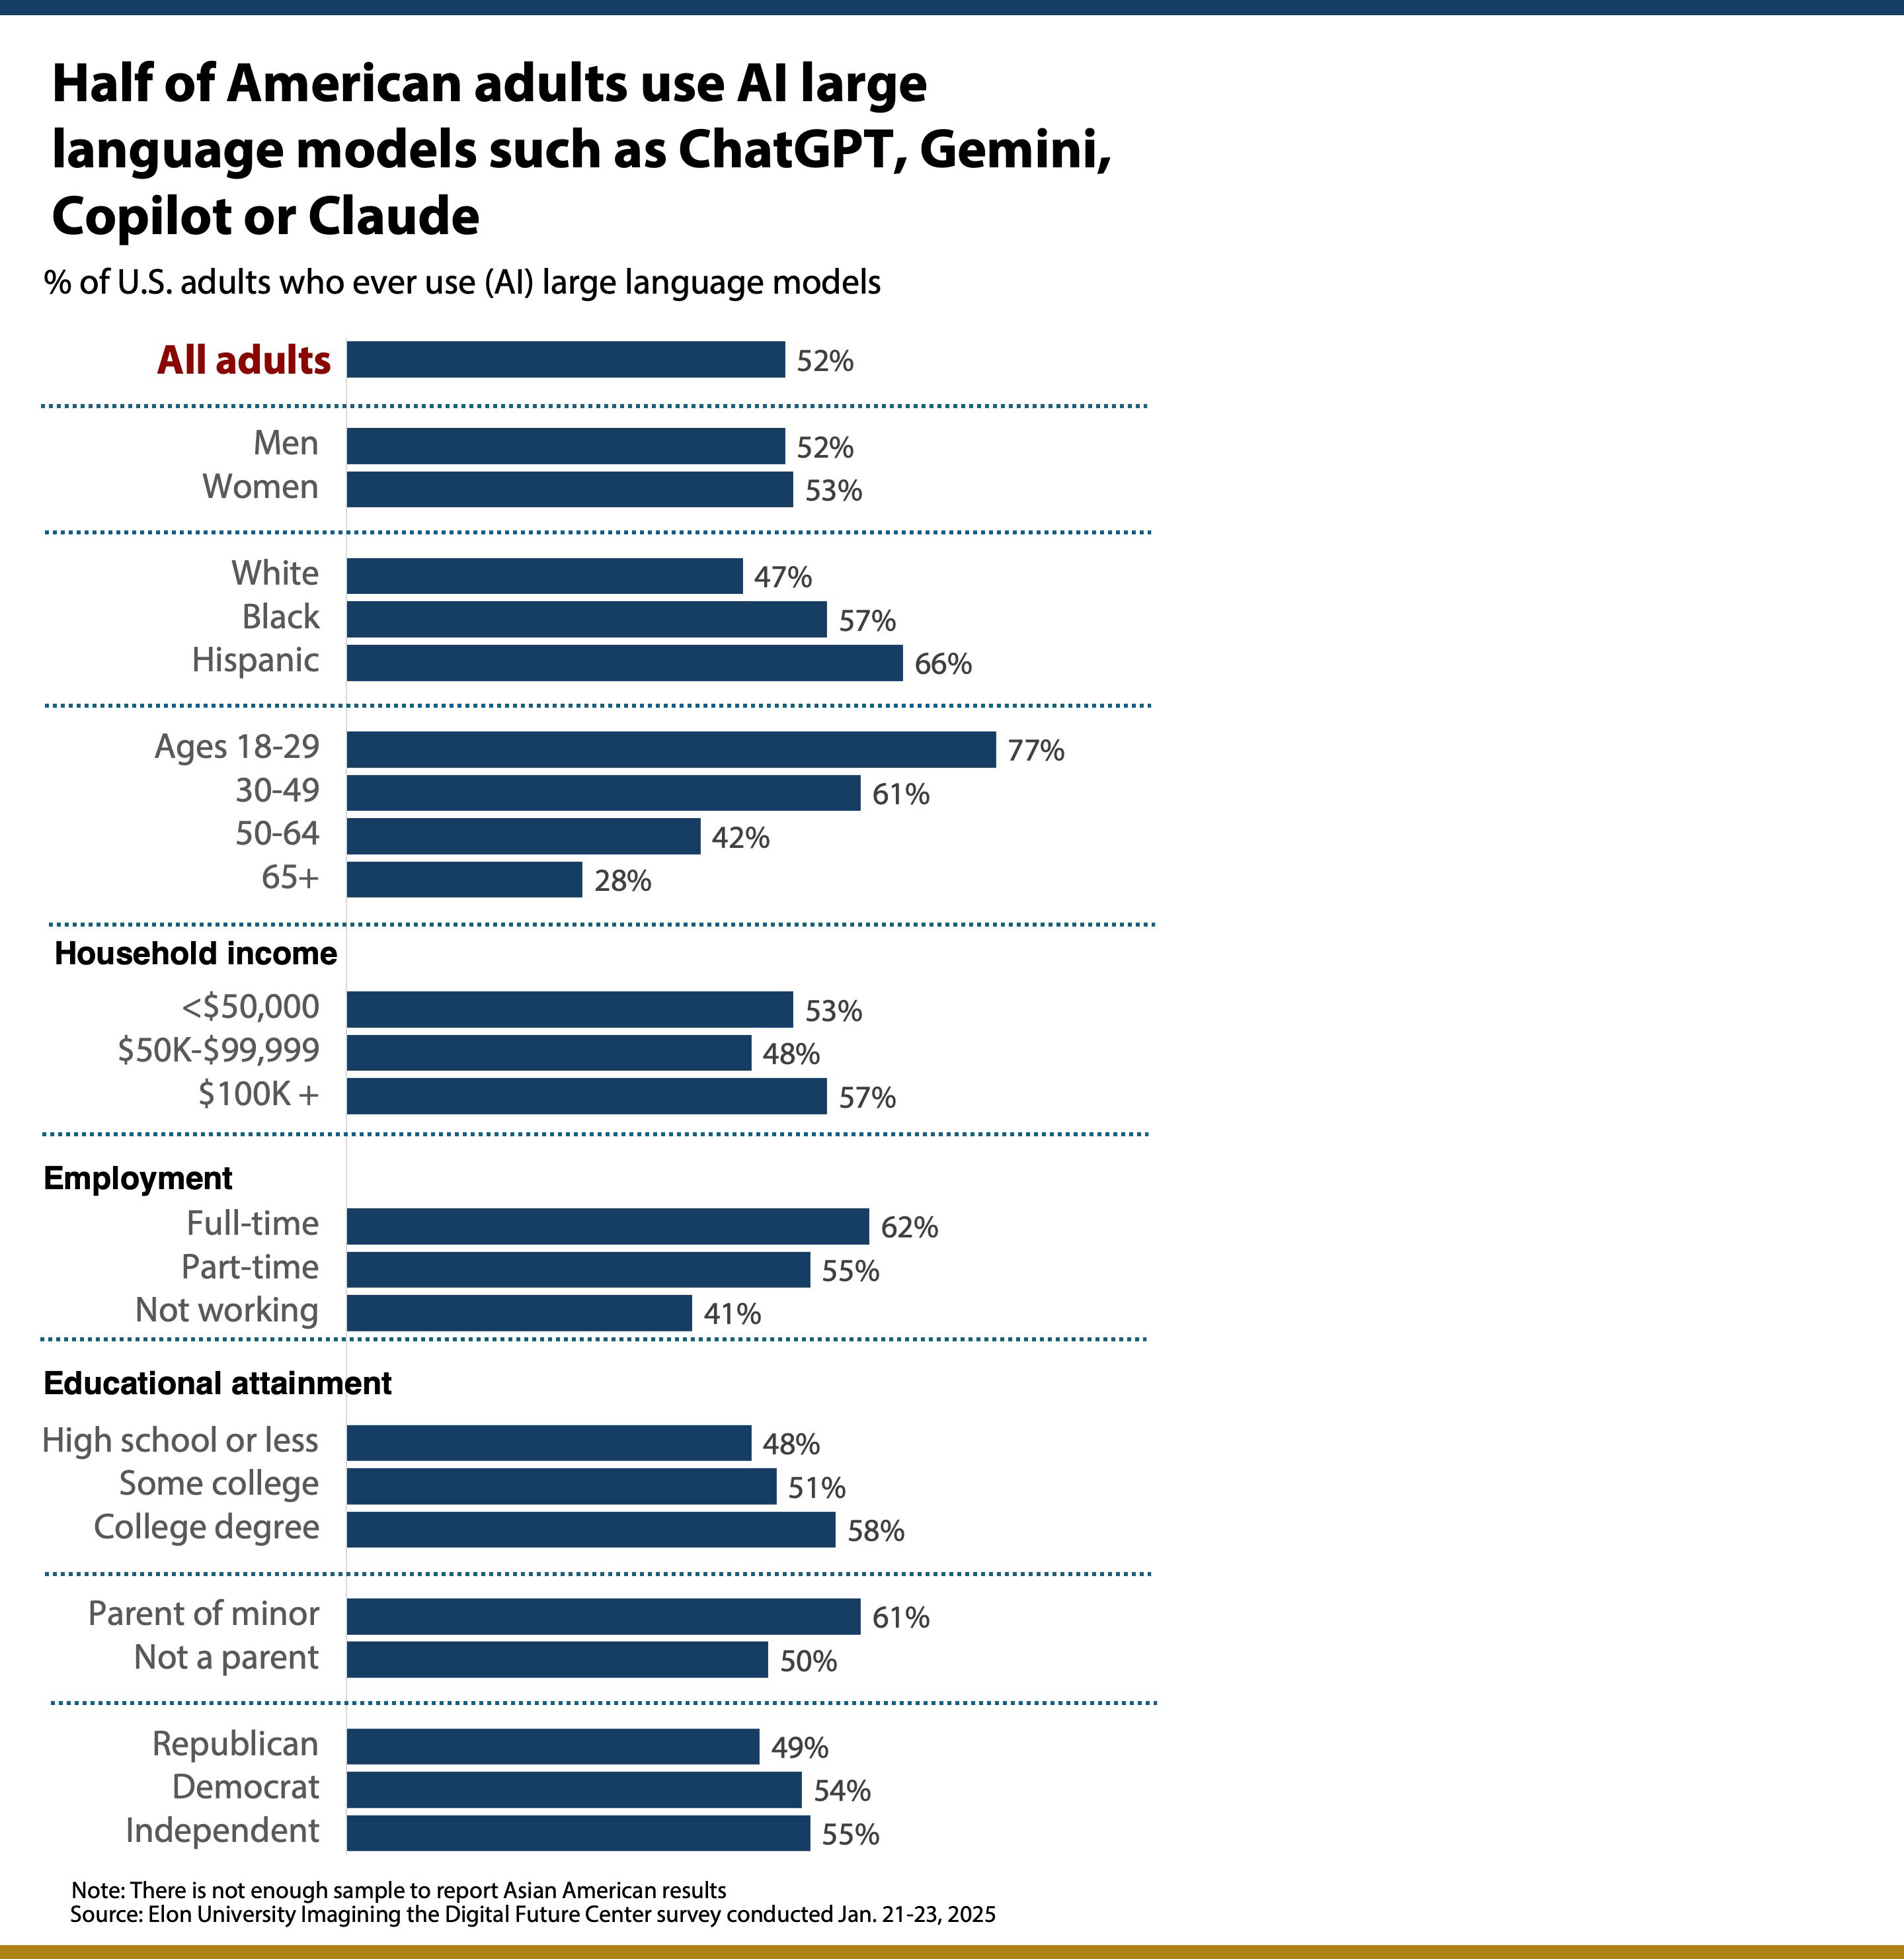

Slide 4
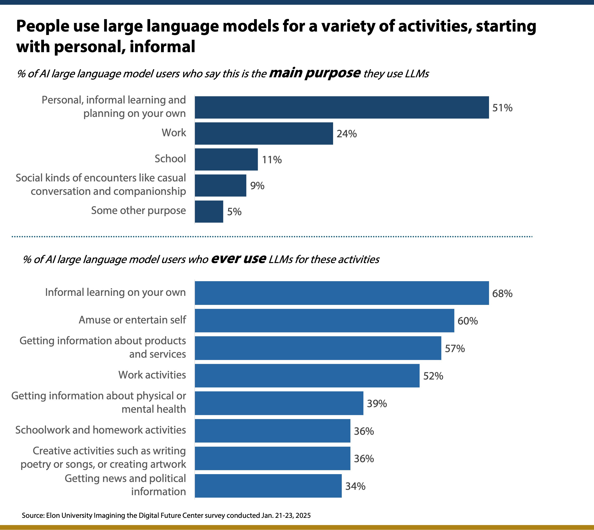

Slide 6
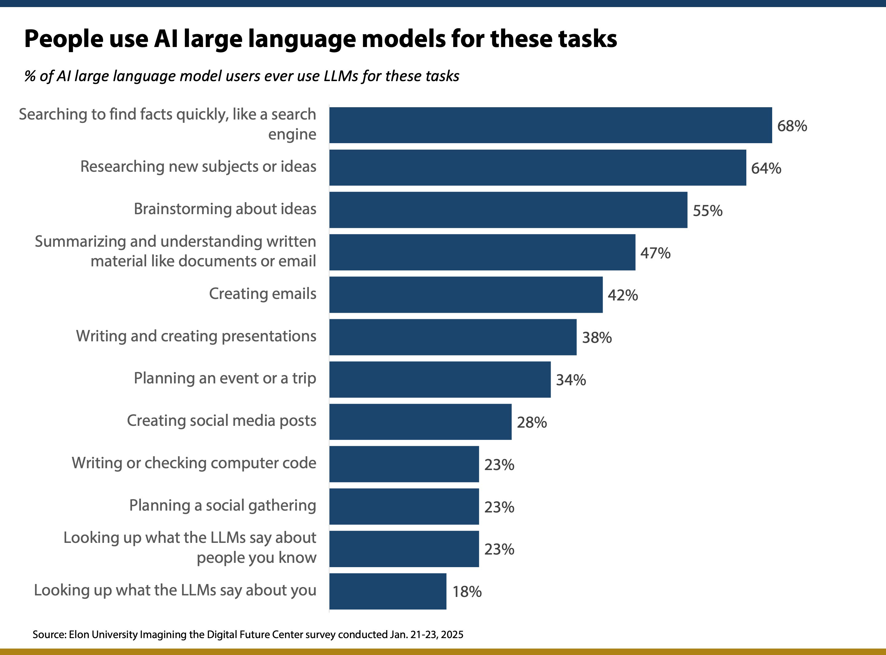

Slide 7
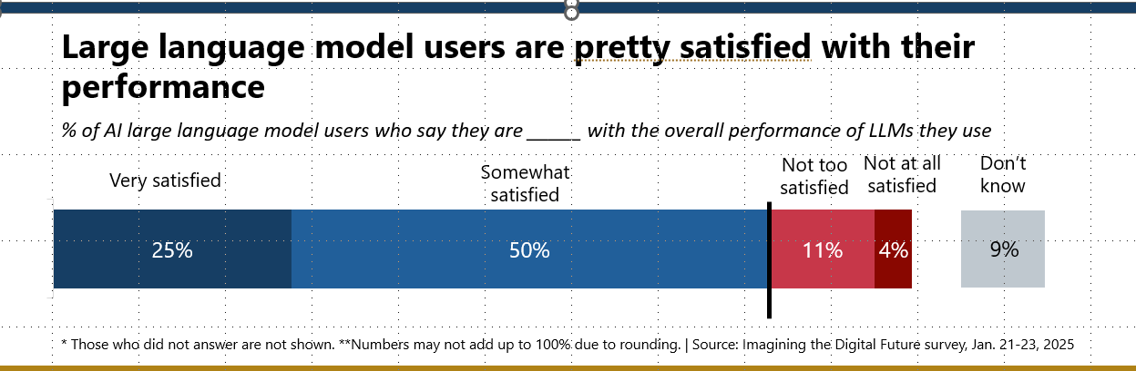

Slide 8
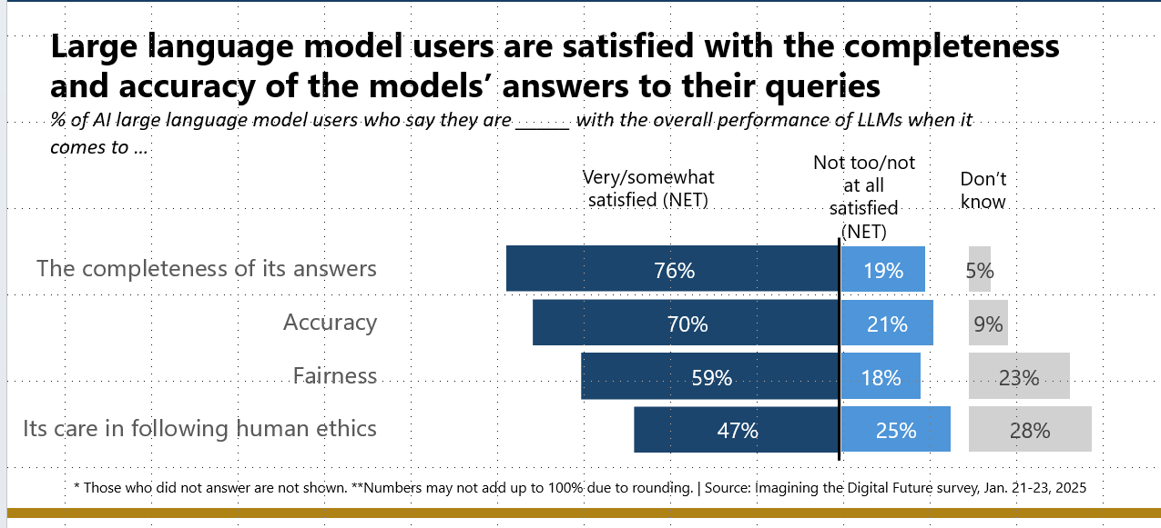

Slide 9
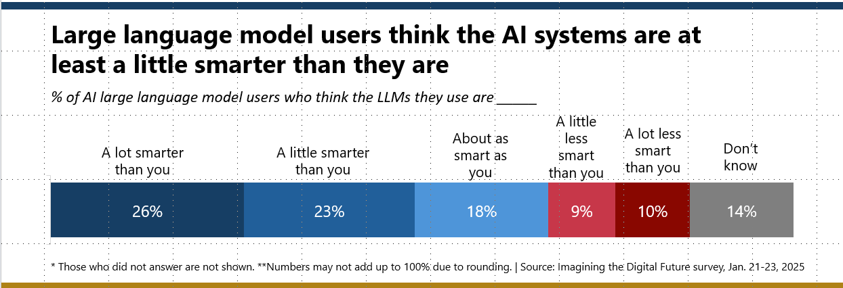

Slide 10
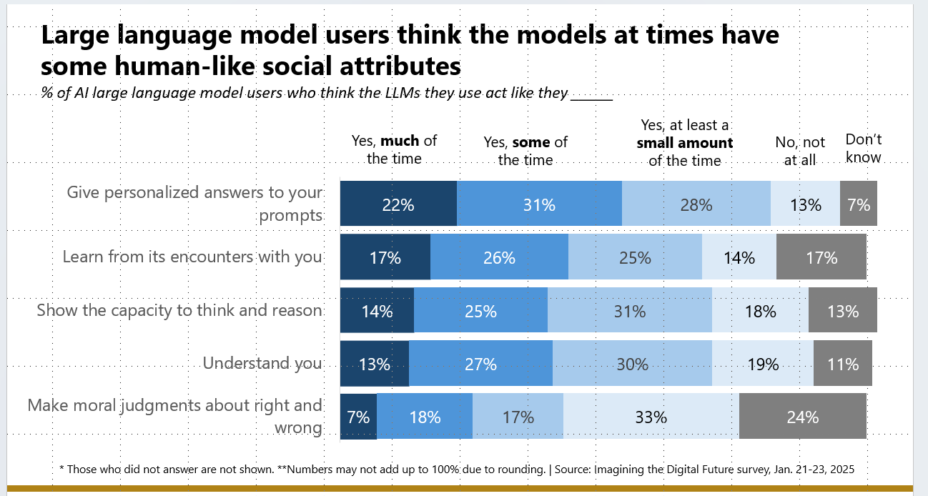

Slide 11
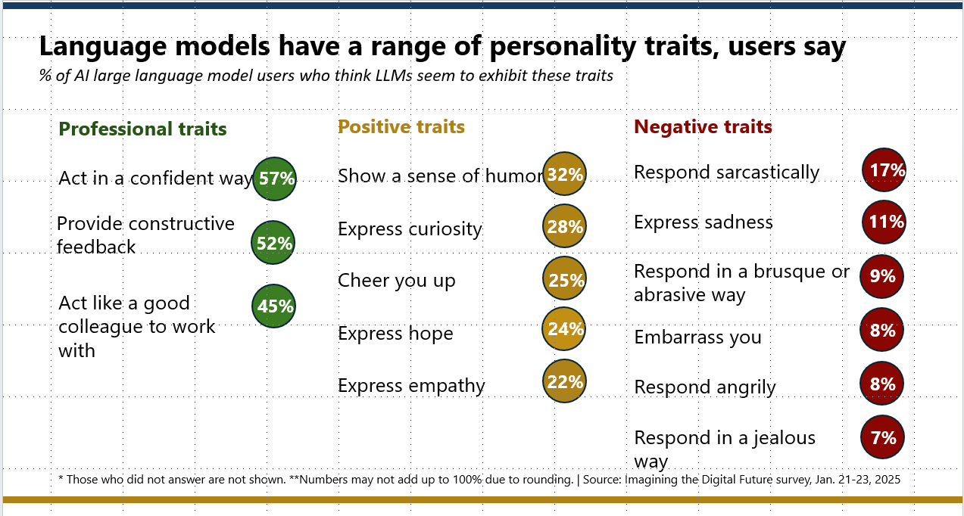

Slide 12
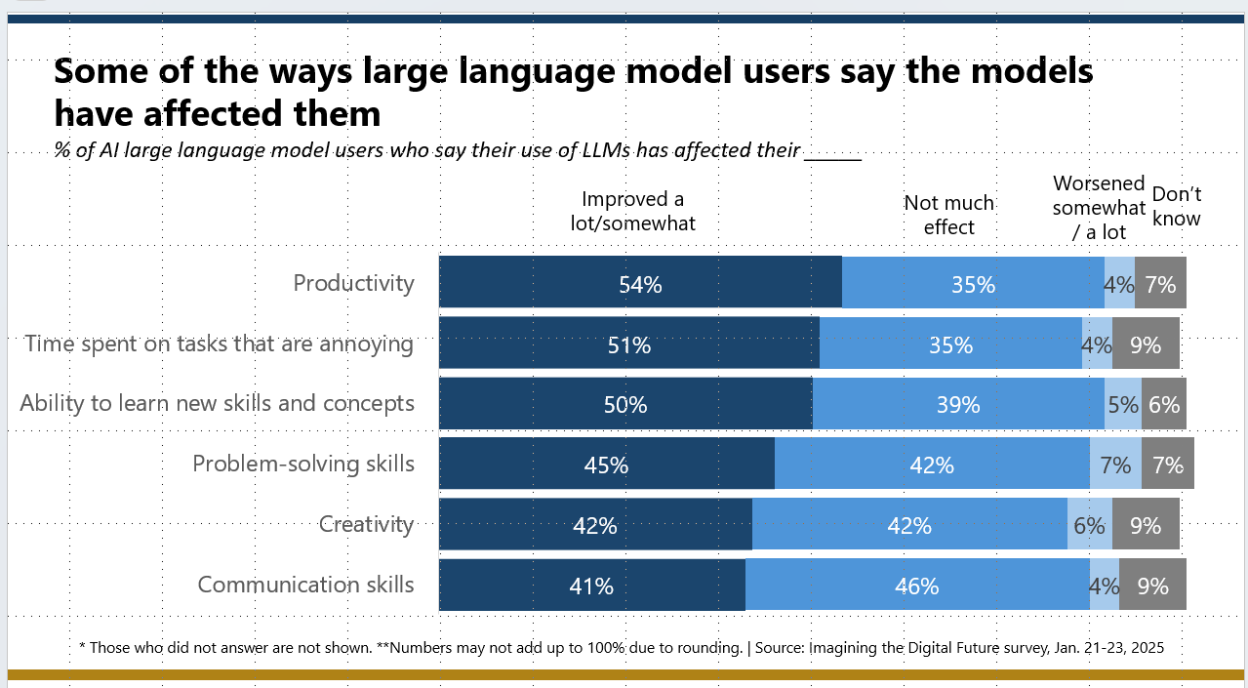

Slide 13
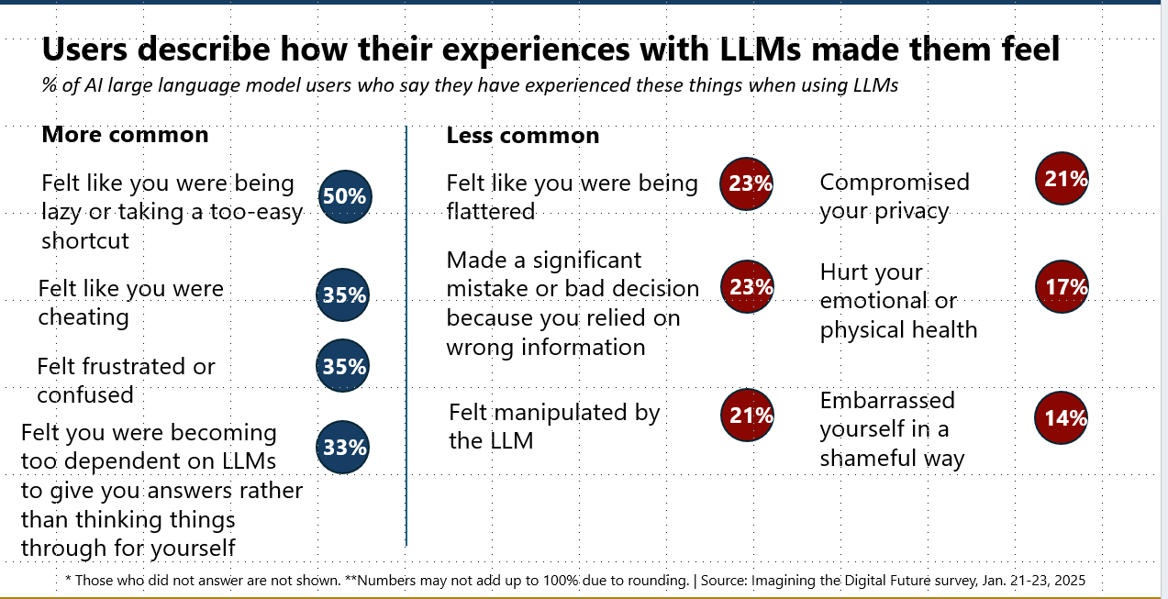

Slide 14
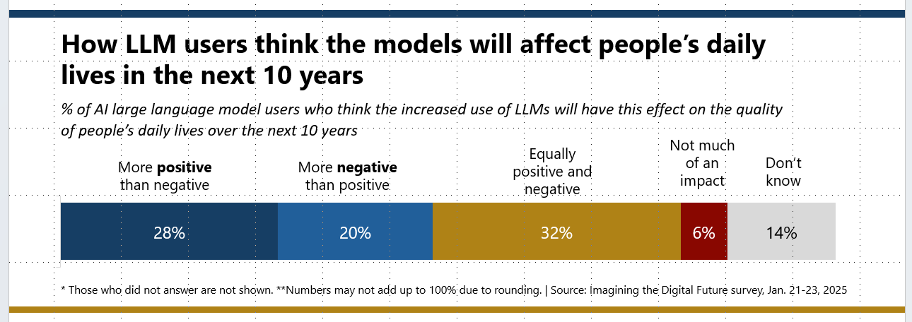

Slide 15
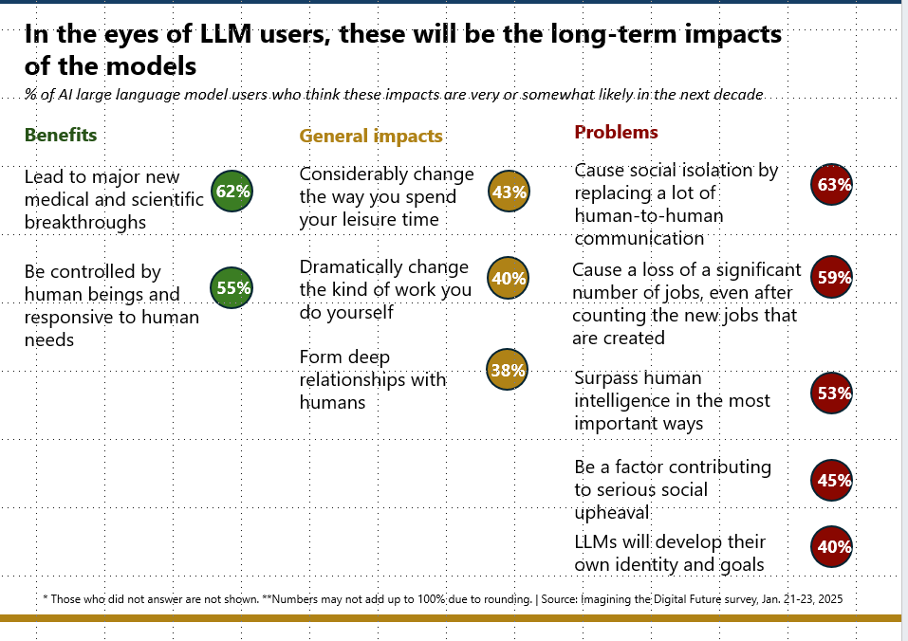

Slide 16
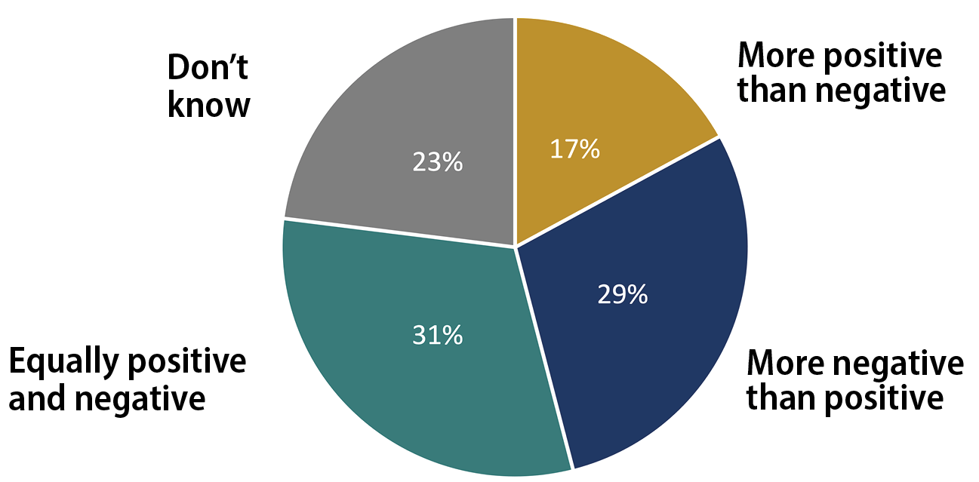
The National Public Opinion Poll
Overall, what will be the impact of increased use of artificial intelligence (AI) on the quality of people’s daily lives?

Slide 17
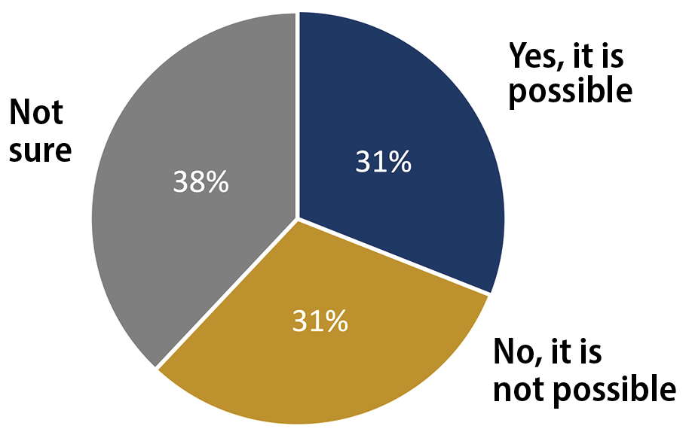
The National Public Opinion Poll
Do you think it is possible or not possible for people to design AI computer programs that can consistently make decisions in people’s best interest in complex situations?

Slide 18
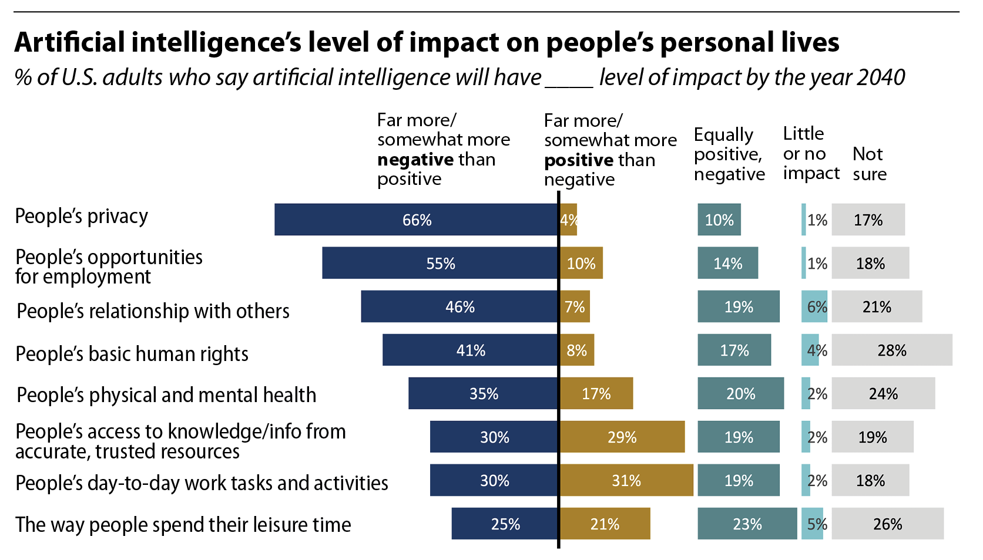
Opinion about AI’s social impacts

Slide 19
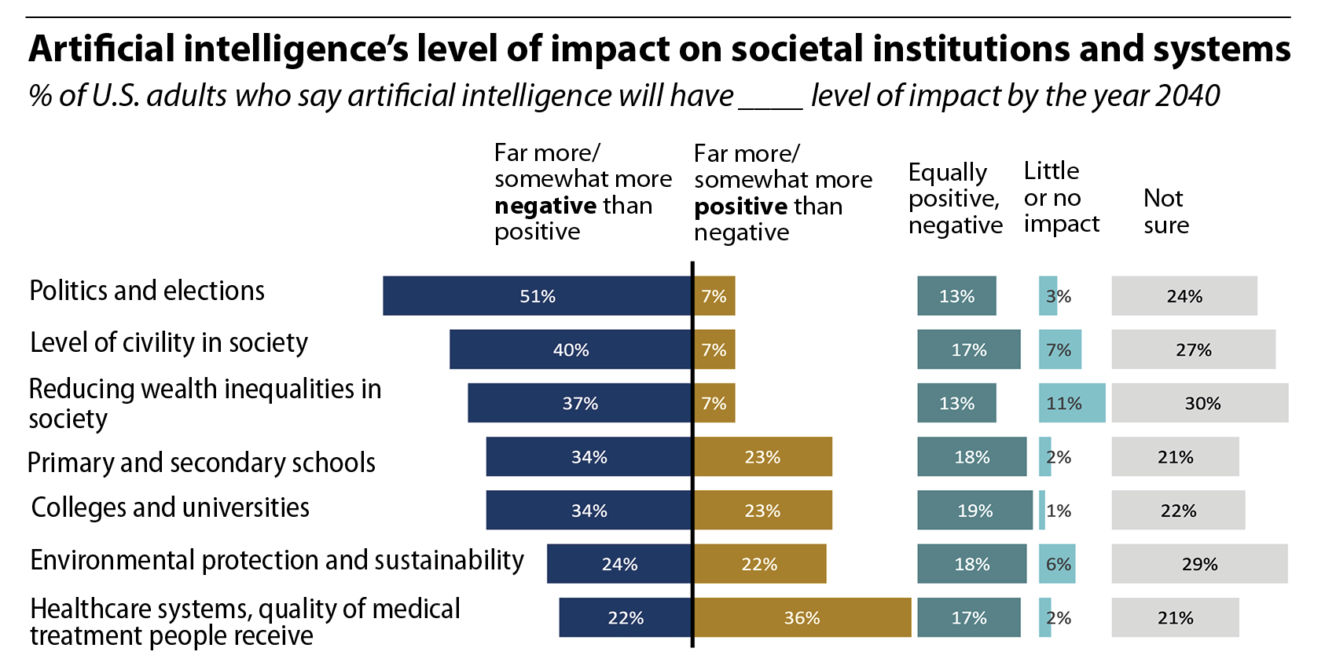
Opinion about AI’s societal impacts

Slide 20
What’s ahead: 2,778 experts say AI will …
2026: Win World Series of poker
2027: Convincingly fake a song by a popular artist
By 2031 write an original Top 40 song
2030: Fold laundry
2033: Retail salesperson job functions will be fully automated
2035: Independently research and write high-quality machine learning paper
2040: Physically install electric wiring in a new home
2045: Prove math theorems for top math journal
2050: Solve long-standing unsolved problem in math and win Millennium Prize
Major takeaway: For most tasks, expert timelines to success shortened
Thousands_of_AI_authors_on_the_future_of_AI.pdf (aiimpacts.org)
Thousands_of_AI_authors_on_the_future_of_AI.pdf (aiimpacts.org)

Slide 21
What’s ahead: 2,778 experts say AI will …
2047: High-level machine intelligence is better and cheaper to implement than all humans -- down 13 years from earlier predictions
2116: Full automation of labor -- down 48 years from earlier predictions
Thousands_of_AI_authors_on_the_future_of_AI.pdf (aiimpacts.org)
Thousands_of_AI_authors_on_the_future_of_AI.pdf (aiimpacts.org)

Slide 22
Lee Rainie
Director ITDF
lrainie@elon.edu

