Slide 1


Another darn crossroads
How libraries can function in the emerging world of generative AI
Lee Rainie
NEFLIN
4.25.25
Notes:
Another darn crossroads: How libraries can func
Keynote Speaker Lee Rainie will discuss how the lessons learned by libraries by prior digital disruptions caused by broadband connections, mobile connectivity, and social media can be applied by librarians to the challenges posed by GenAI. Rainie, a longtime library analyst at the Pew Research Center, will cover the latest research trends and invite librarians to ponder how they can help patrons navigate this new world.tion in the emerging world of Generative Artificial Intelligence

Slide 2

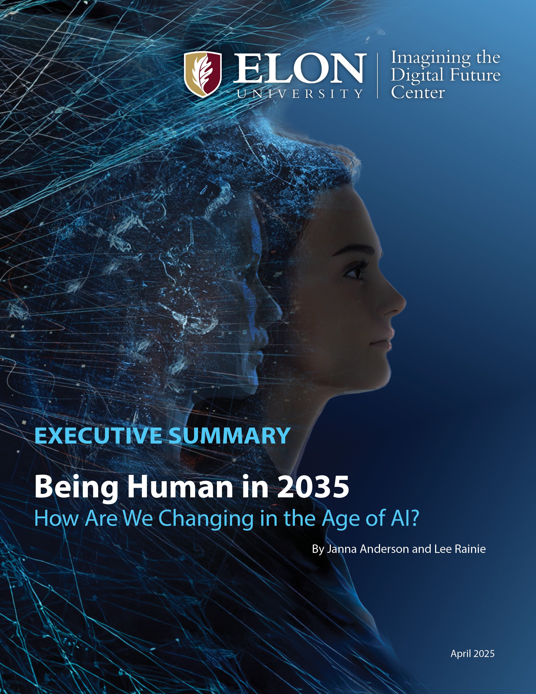
https://imaginingthedigitalfuture.org/reports-and-publications/being-human-in-2035/

Slide 3
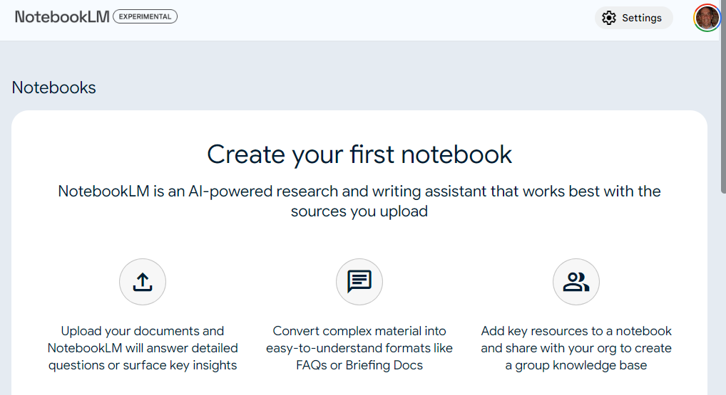
Report from the AI frontline

Slide 4
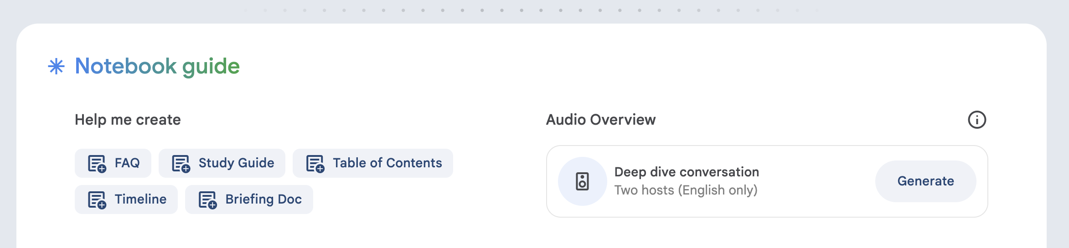
Report from the AI frontline

Slide 5
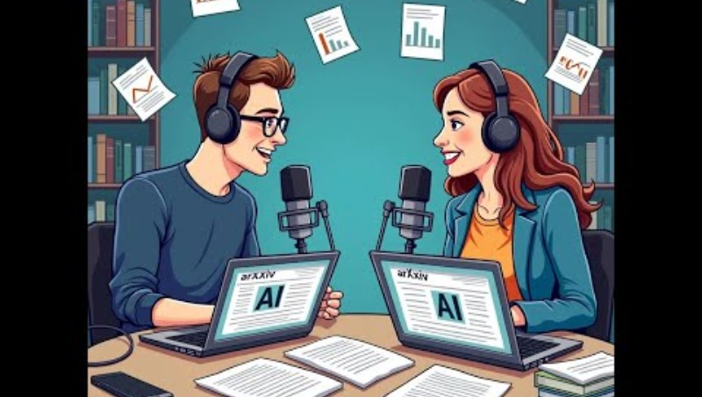
Report from the AI frontline
https://www.youtube.com/watch?v=XkAaFcLrP7k

Slide 6

The Next Library
The keys to the future once you answer 7 questions
Memory Lane ….
Lee Rainie - @lrainie
Director
Pew Research Center’s Internet & American Life Project
Presented to: NEFLIN
June 19, 2013

Slide 7
The big questions
What’s the future of knowledge?
What’s the future of reference expertise?
What’s the future of public technology?
What’s the future of learning spaces?
What’s the future of community anchor institutions?

Slide 8
6. Where do you fit on the dashboard?
ALA’s “Confronting the Future”
Totally physical (facilities and media)
Individual focus
Collection library (physical and virtual)
Portal
Everything for everyone
Totally virtual (facilities and media)
Community focus
Creation library (social, maker space)
Archive
Specialized niche

Slide 9
The big questions
7. What’s the franchise vs. what’s the commodity …
... in the Age of Generative AI?

Slide 10
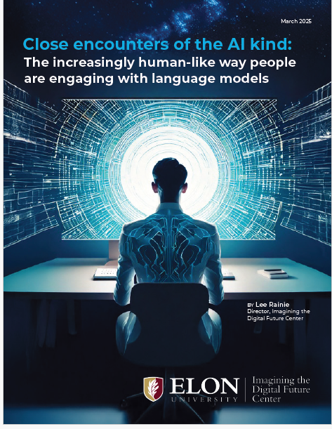
https://imaginingthedigitalfuture.org/reports-and-publications/close-encounters-of-the-ai-kind/

Slide 11
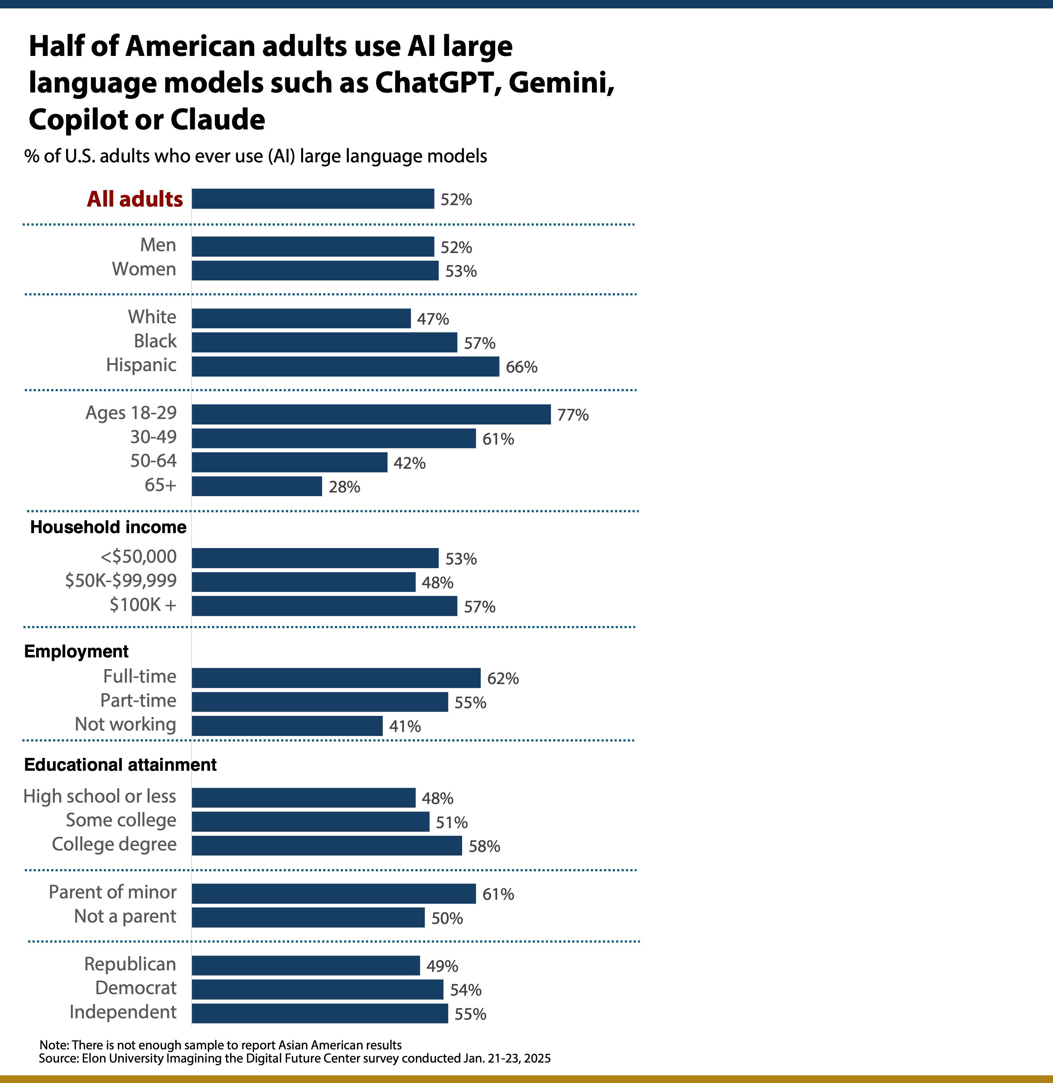

Slide 12
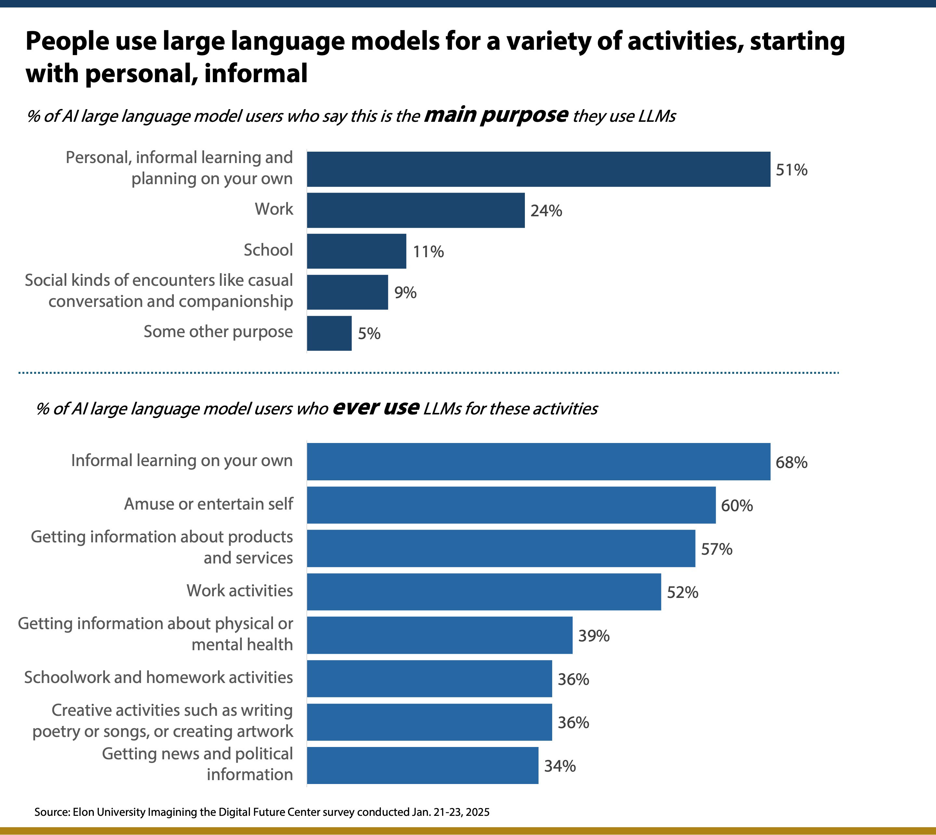

Slide 13
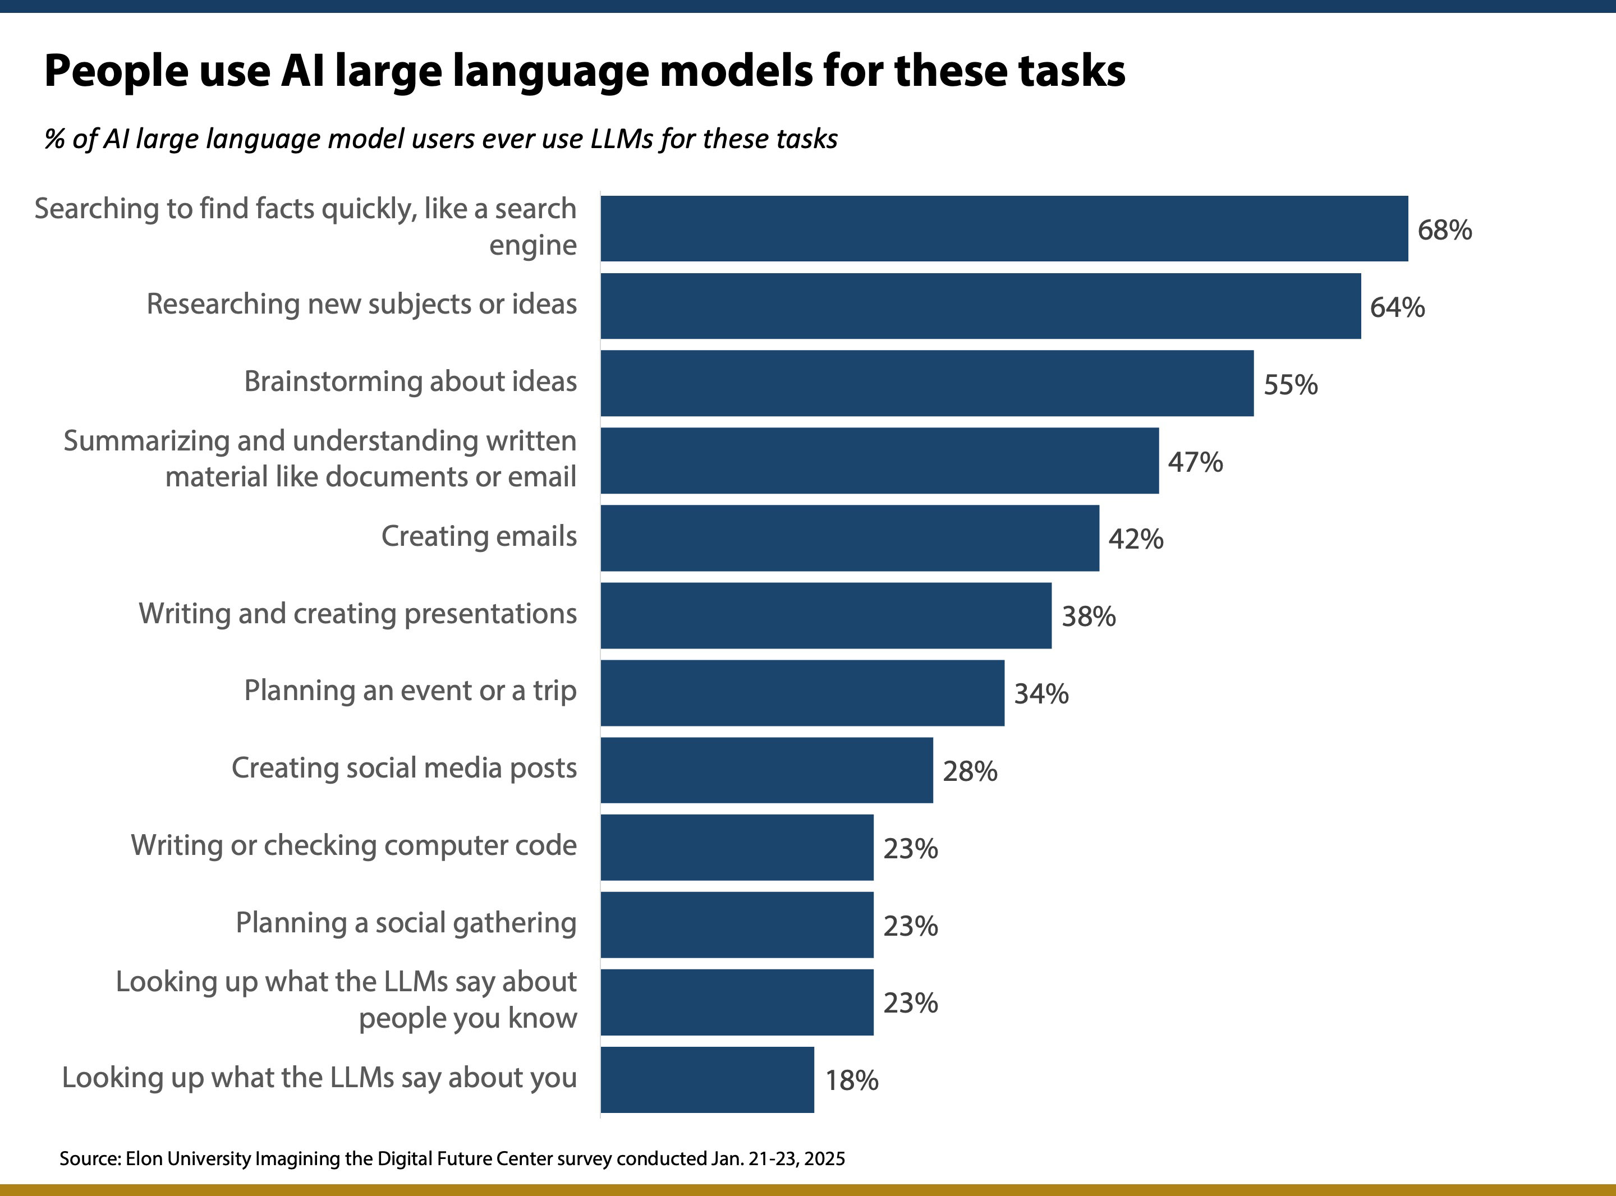

Slide 14
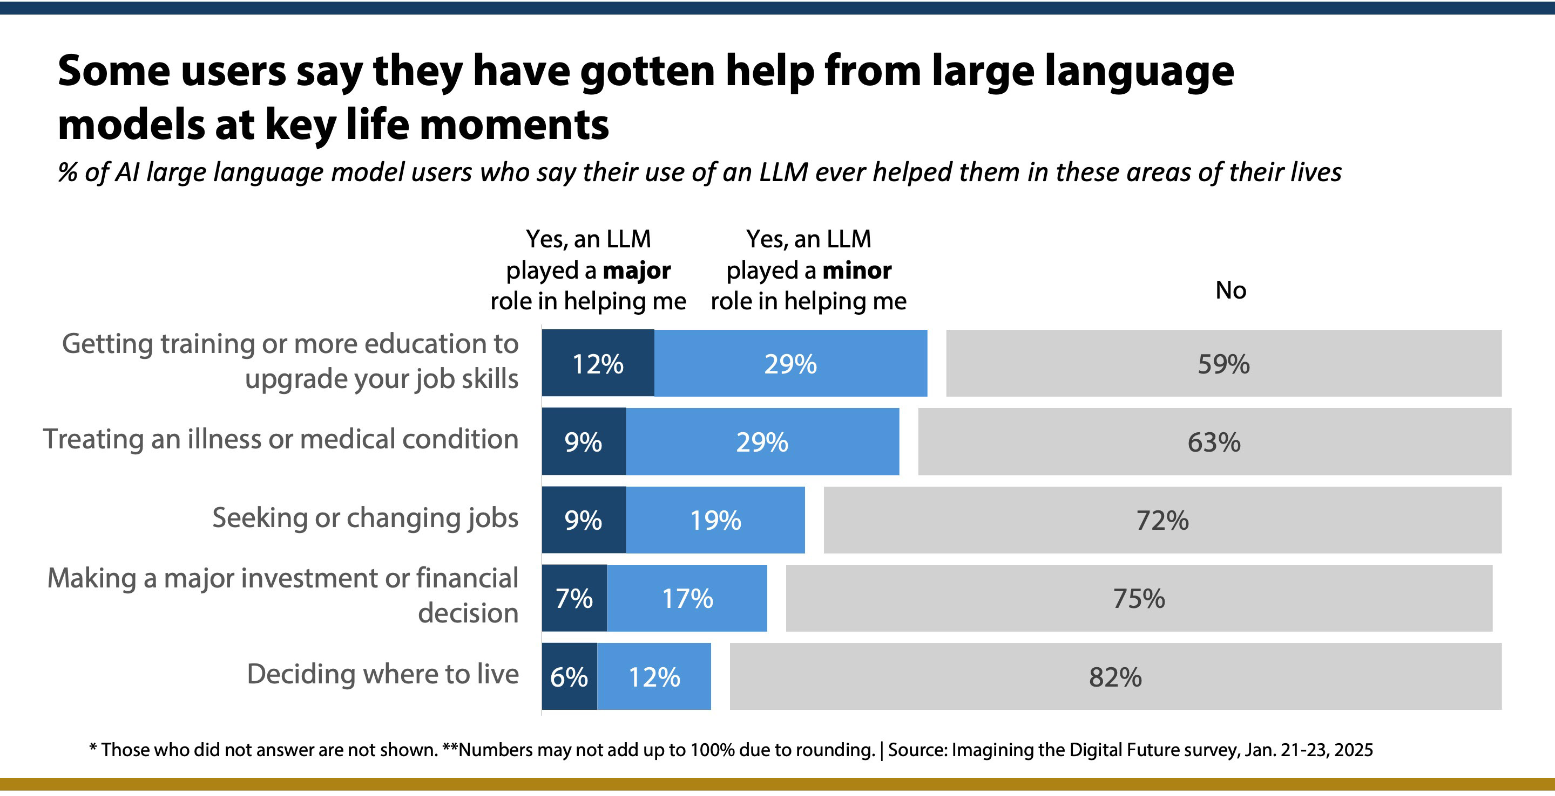

Slide 15
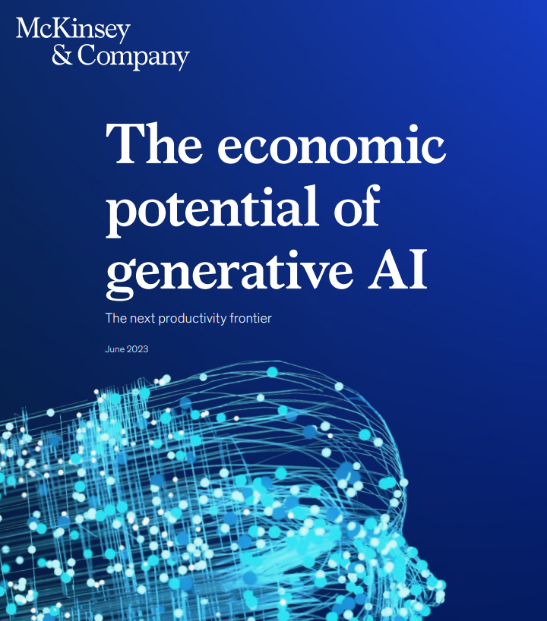
Why it matters economically
Estimates suggest it could add between $2.6 trillion and $4.4 trillion annually across 63 use cases analyzed
McKinsey & Company

Slide 16
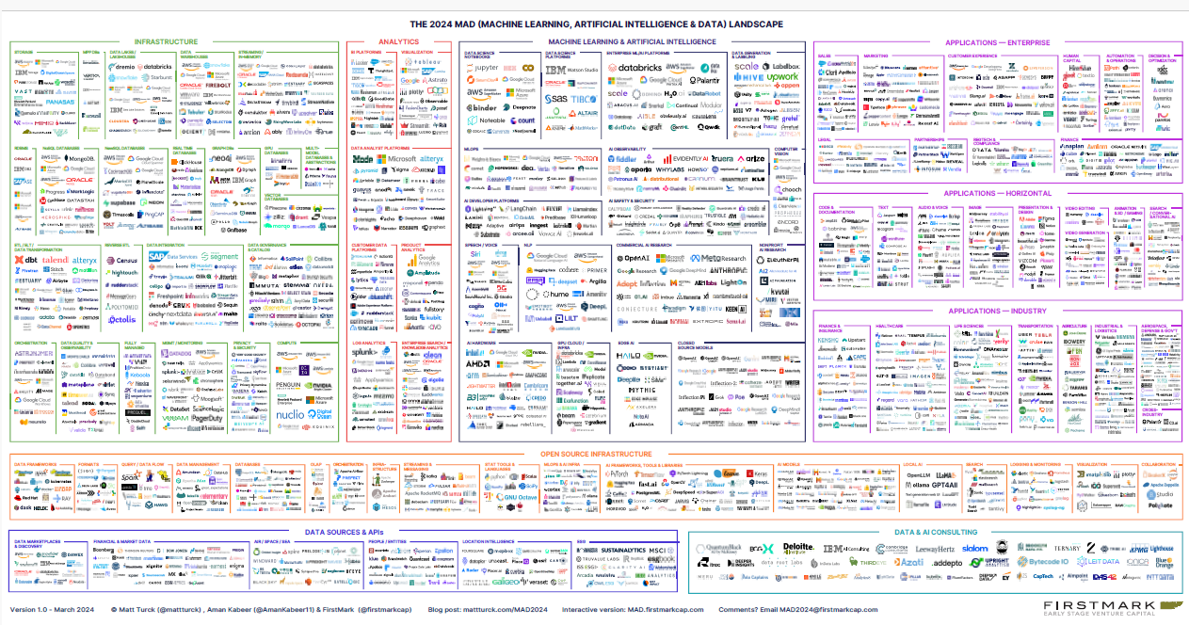
Infrastructure
Applications and Enterprise
Analytics
Machine Learning & AI
Data governance
Privacy
Security
AI Observability
Safety
Speech-voice
Nonprofit
Applications - Horizontal
Applications - Industry
Open Source Infrastructure
Data Sources and APIs
Data and AI Consulting

Slide 17
Why GenAIs matter socially and politically
GenAIs will create different secondary and tertiary effects than social media did. Social media is optimized for attention and engagement. GenAIs are being optimized for intimacy in liberal democracies … and population control/surveillance by
authoritarian regimes.

Slide 18

This evolution is challenging
There will be an ever-shifting boundary between what’s human intelligence and what’s machine intelligence

Slide 19
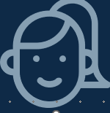


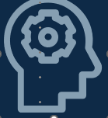
This evolution challenges us all to reimagine …
Who we are: What happens when superior intelligence is all around us?
What we do: How do we change as GenAI agents help us and represent us?
How we connect: What becomes of trust as GenAI content becomes part of civic news and info ecology?
How we think: What shifts occur in our decision-making when augmented intelligence is everywhere?
Notes:
Who we are: These experts wonder what will happen to our sense of identity and self-worth when we see AIs being able to perform some human functions as well as or better than we can. That raises some obvious questions: How will that affect the many workers who anchor their sense of self in their careers – and who will see that AIs have mastered or bettered their skills? How will everyone feel when they live in a world that is heavily influenced by superior forms of intelligence that are not human?
What we do: There will also be advances in AI systems will force people to reckon with their sense of agency and free will. AI co-pilots are already starting to help some people stay informed and even take action on their behalf. This trend is about to be significantly magnified. A large share of the population will likely trust these agents because the AI systems will become ever better at reading us, mimicking our actions and predicting and steering our behavior. Thus, the questions: What do we lose when we come to rely on AI sidekicks and we even outsource ourselves to AI agents? What will people do when much more human activity is mediated in some way by AIs?
How we connect and share: One of the great human triumphs is our capacity to work with others to discover truth, solve problems and provide mutual support. What happens to these traits in a world in which AIs personalize the flow of information and the flow of fellowship among people. It will also be a world where “synthetic” information – potentially carrying people’s pre-existing biases or being faked altogether – will become a larger part of the information landscape. At the extreme, some of these experts envision an AI-dominated world where every person is shaped by an individualized “reality” and belief system in which shared experiences and shared truths are difficult – if not impossible – to realize.
How we think: Many of these experts believe that the nature of human cognition itself will be altered by AIs as we become increasingly experts believe that the nature of human cognition itself will be changed by AIs as we become more dependent on them. This could enfeeble people, decimating their aptitude for critical thinking and being skeptical. Moreover, there is plenty to fear about AI programs’ impact on people who prize their talents to create and innovate. How do those deep-seated sensibilities adjust to the onslaught of AIs?

Slide 20
Remember the big question from 2013
7. What’s the franchise vs. what’s the commodity …
... in the Age of Generative AI?

Slide 21

Stake your claim on being human

Slide 22
https://imaginingthedigitalfuture.org/reports-and-publications/being-human-in-2035/

Slide 23
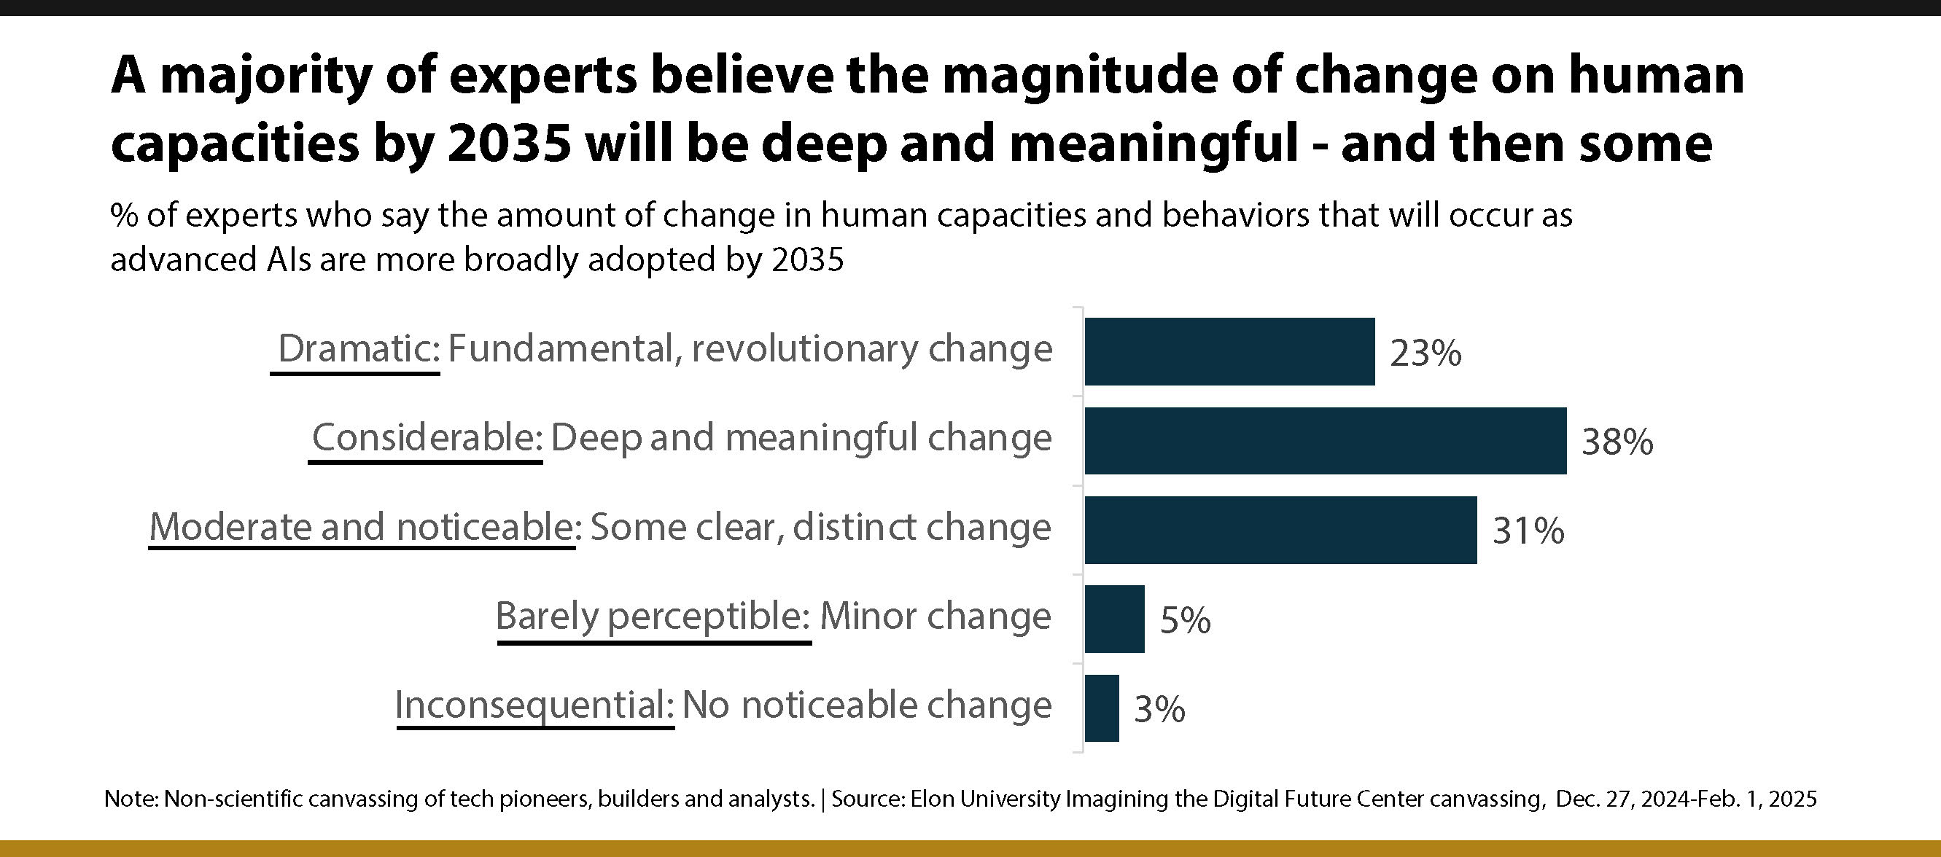

Slide 24
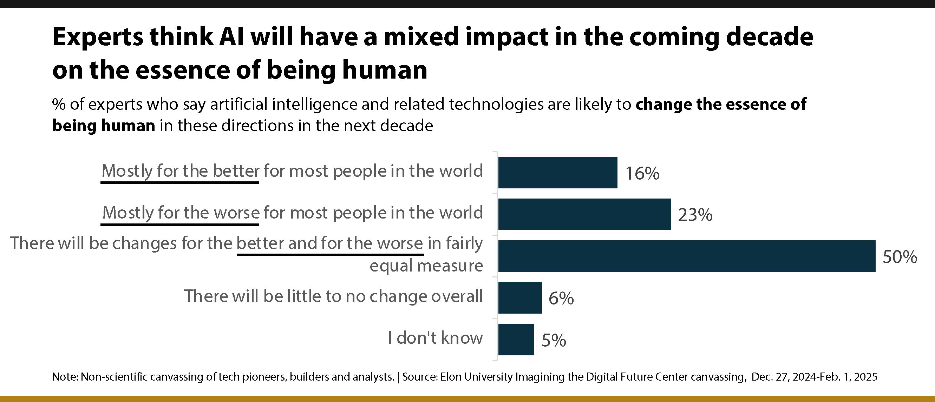

Slide 25
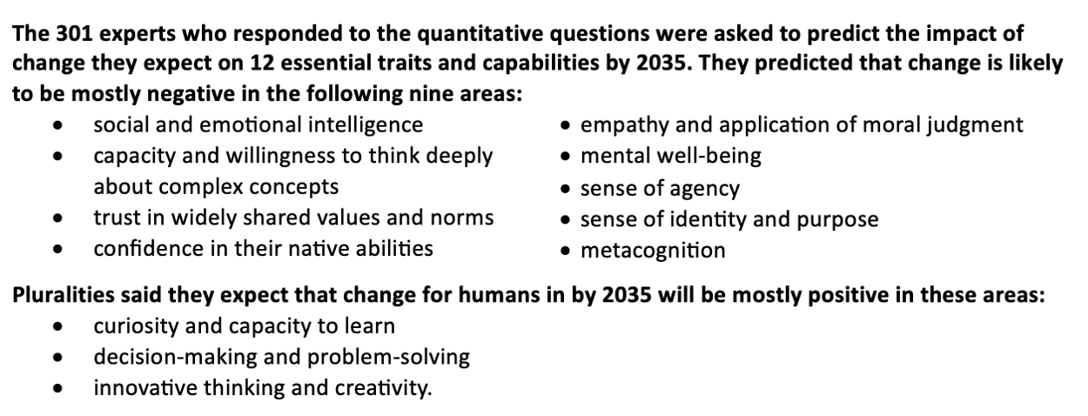

Slide 26
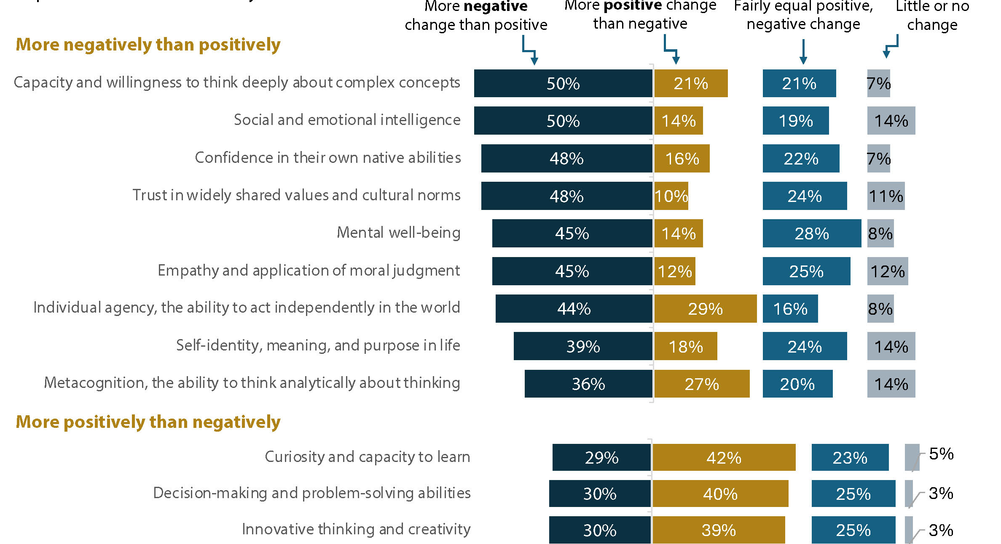
Emotional
Social
Internal
Instrumental
External
Actionable

Slide 27
Roles for libraries
Reimagine how services and roles can be divided
What is AI better at? What can humans be freed to do?
----- answering basic patron reference questions
----- routine circulation and scheduling chores
----- basic marketing
            ----- cataloguing materials
            ----- performance metrics for collections and patrons
            ----- others?

Slide 28
Roles for libraries
Centers for AI literacy and digital empowerment
Offer AI literacy workshops covering how AI works, data privacy, algorithmic bias, and ethical considerations.
Curate AI explainer materials tailored to different age groups and learning levels.
Provide open access to AI experimentation tools (e.g., LLM interfaces, coding sandboxes, chatbot demos) with human guides.
Develop train-the-trainer models to help educators, librarians, and community leaders bring AI education to their networks.

Slide 29
Roles for libraries
Transform libraries into human-AI collaboration spaces
Place special emphasis on aiding workers during a time of massive labor force transition.
Develop personalized learning, coaching, mentoring services.
Offer co-working spaces with AI assistants where patrons can get help drafting documents, coding, researching, or brainstorming.
Host design-thinking labs where citizens co-create ideas and solutions alongside AI systems and librarians.
Provide maker spaces and digital studios with AI-enhanced creative tools (e.g., music generation, graphic design, storytelling).

Slide 30
Roles for libraries
Preserve human memory and cultural context
Serve as “experience orchestrators” of learning and engagement with media.
Become community ethnographers. Develop digital archives of oral histories, community narratives, and underrepresented voices to feed more inclusive AI training sets.
Use AI to augment digital preservation (e.g., repairing old documents, organizing historical material) without losing human curatorial control.
Partner with artists and scholars to document and reflect on society’s evolving relationship with AI.

Slide 31
Roles for libraries
Curate trustworthy, human-vetted knowledge systems
Reinforce the library’s role as a truth filter by curating vetted content, teaching fact-checking, and offering media literacy programs.
Partner with academic institutions to preserve and elevate human-authored knowledge that could otherwise be drowned out by AI-generated noise.
Develop and maintain hybrid knowledge systems where AI recommendations are moderated by human librarians, enhancing trust.

Slide 32
Roles for libraries
Serve as ethical stewards and AI watchdogs
Advocate for transparent, open-source, and community-governed AI systems.
Provide public briefings on AI policy, surveillance, and the risks of bias in algorithmic decision-making.
Build data privacy literacy programs and offer privacy-enhancing digital tools to protect patrons.

Slide 33
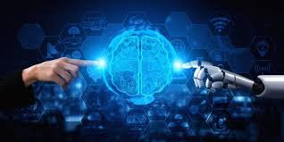
Hybrid intelligence: The work ahead
Reclaim your identity as sanctuaries of human insight, empathy, and public empowerment. The next generation of library workers will be community technologists, ethical educators, and humanists, stewarding people’s shared journey through the digital age.
Notes:
Humans are uniquely capable of asking "big questions" about the nature of existence, meaning, and purpose. By engaging with these deeper aspects of knowledge, humans bring depth and richness to intellectual exploration that LLMs cannot provide.

Slide 34
Lee Rainie
Director ITDF
lrainie@elon.edu

